Slide 1
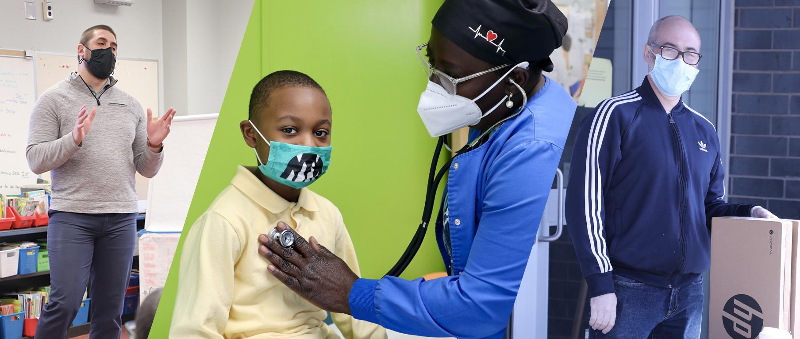
2020 Comprehensive Annual Financial Report: Student Art Contest Winners
Celebrating the Heroes of COVID-19

Slide 2
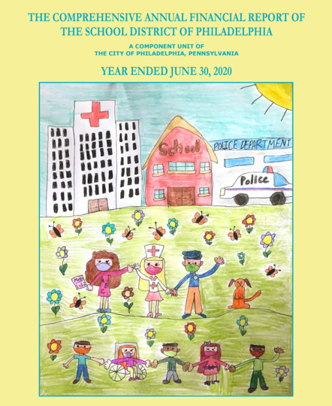
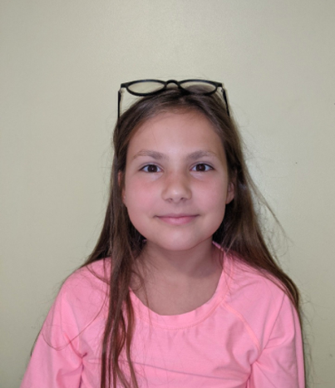
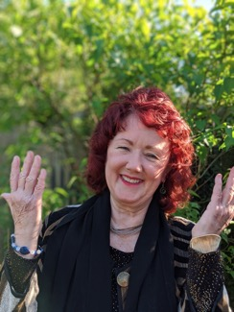
Alexandra Volyanyuk, Grade 4
Loesche Elementary School
Ms. Mary Lisabeth Shean

Slide 3
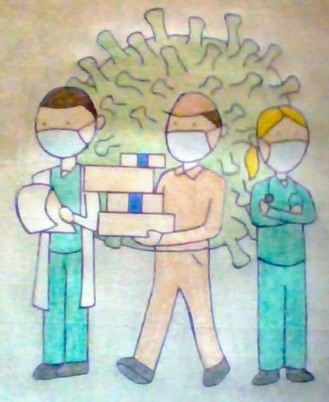
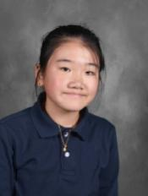
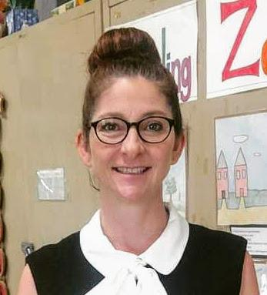
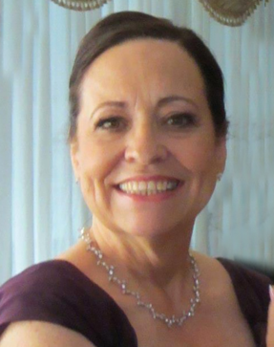
Vivian Chen, Grade 7
Wilson Middle School
Ms. Kimberly Colasante

Slide 4
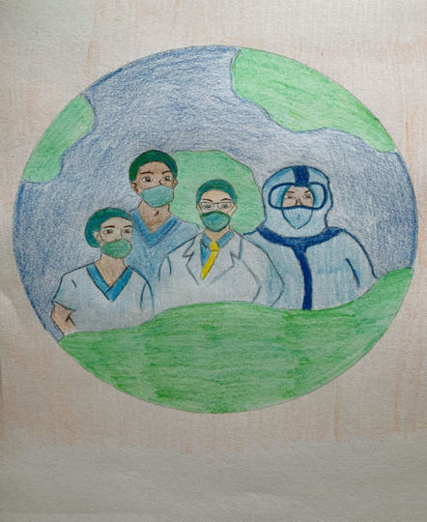
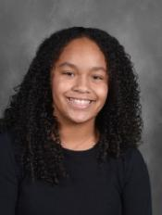
Jada Jankauskas, Grade 7
Wilson Middle School
Ms. Kimberly Colasante

Slide 5
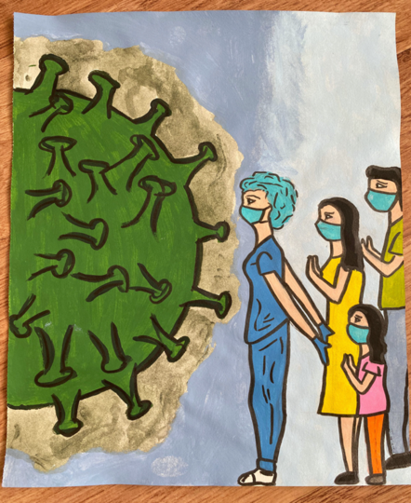
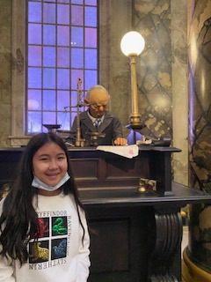
Kamilla Charimova, Grade 5
Loesche Elementary School
Ms. Mary Lisabeth Shean

Slide 6
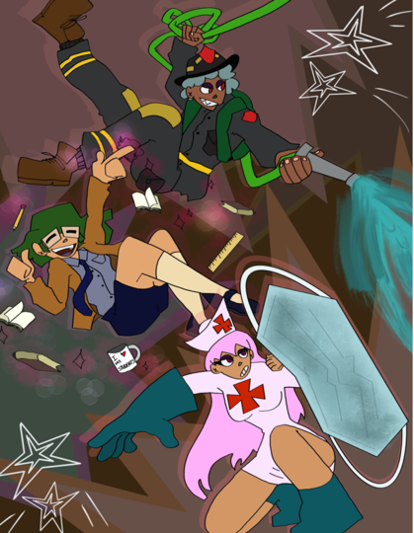
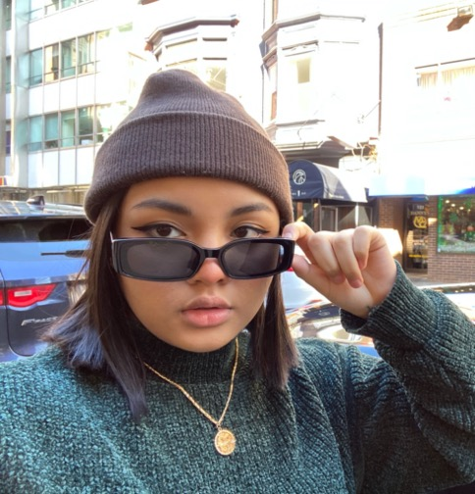
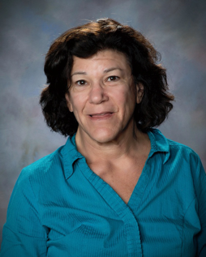
Masiya Mom, Grade 12
Northeast High School
Ms. Marsha Rosenthal

Slide 7
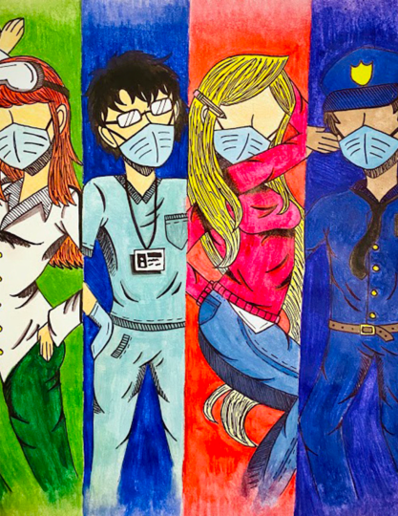
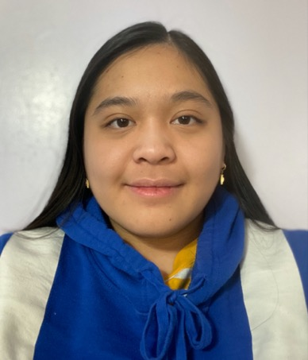
Thuong Nguyen, Grade 12
Northeast High School
Ms. Marsha Rosenthal

Slide 8
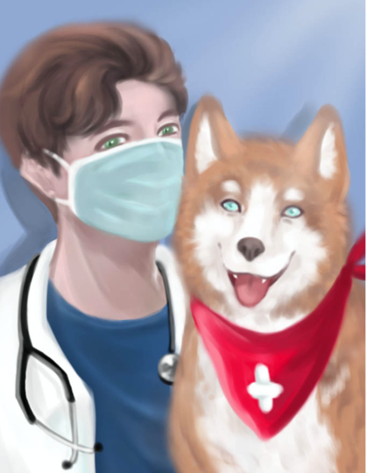
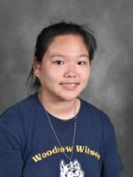
Alice Huang, Grade 8
Wilson Middle School
Ms. Kimberly Colasante

Slide 9
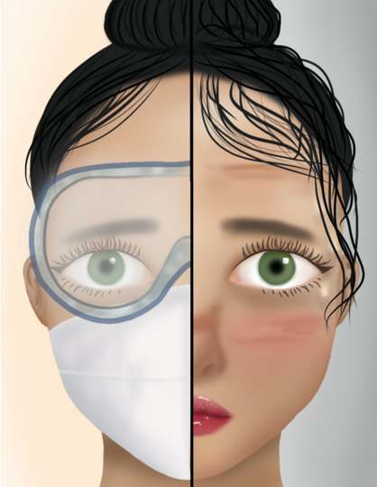
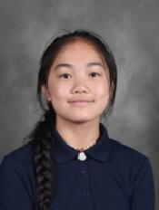
Christina Deng, Grade 7
Wilson Middle School
Ms. Kimberly Colasante

Slide 10
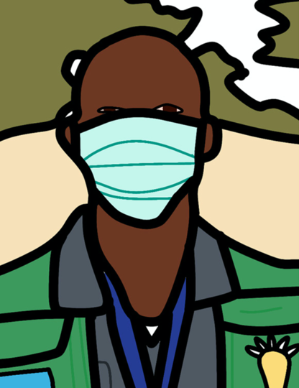
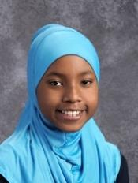
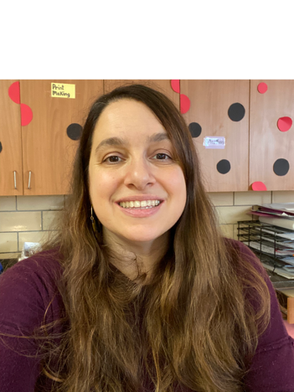
Amber Glenn, Grade 7
Hill-Freedman Middle School
Ms. Maria Benitez

Slide 11
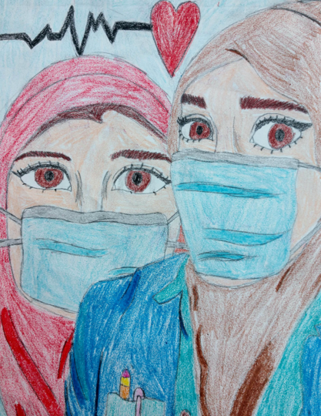
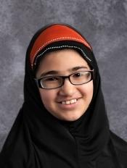
Javeria Javed, Grade 6
Wilson Middle School
Ms. Kimberly Colasante

