Slide 1
Masterman School Library Annual Report 2017-2018 Philadelphia, PA 19130 Bernadette Cooke Kearney Certified School Librarian

Slide 2
Volunteers
Monday- Mary Kate Bonner
Tuesday- Cindy Cassell
Wednesday-Farida Pomerantz
River Algiers
Thursday- Dawn Ang
Nicole Eggerts
Jennifer Sorrentino
Friday-Jean Hunsberger
Robin Karakousis
Della Lazarus

Slide 3
Average Weekly Library Visits
Classes
12 Rostered classes
8 Library Skills Classes
Patrons Before/After School, Lunch Recess, During the Day
2,340 students

Slide 4
Titles
13,992

Slide 5
Annual Circulation of Library Materials
9,732

Slide 6
Circulation Statistics
Nonfiction: 3,351
Fiction: 6,295
Kindle check outs: 439
DVD check outs: 69
Audio book check outs: 19

Slide 7
Library Collection
New Materials
Discarded Materials
234 Books
2 DVDs
Weeded
Lost -49
(Approximately half of these titles are recovered through patron reimbursement; the other half are lost due to failure of patron to check out the item.)
-678

Slide 8
Scholastic Book Fair Profit
Fall: $1,169.06
Paid for library materials and events
Spring: $625
Paid for database Historical Newspapers

Slide 9
Other funding
Home and School Association $500 for series, replacements, requests
O’Neill-Dietel Family $500 for new titles for Mock Newbery Committee
DonorsChoose $472 for PYRCA titles
$672 for NHD materials Amazon Wish List $410
Scholastic Donation $138
Subtotal $2,692 + $862 (Book Fair)
$13.37 (DVDs)
Total $3,567.37

Slide 10
Library Supplies
$231.88

Slide 11
Library Events

Slide 12
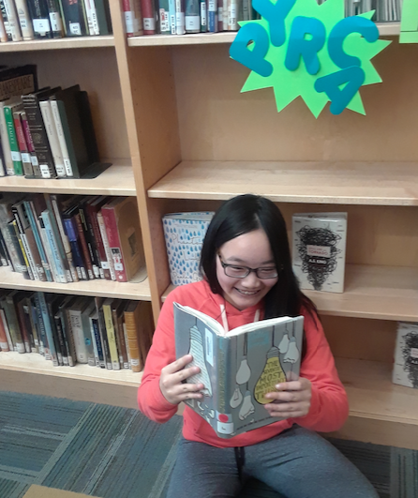

Slide 13
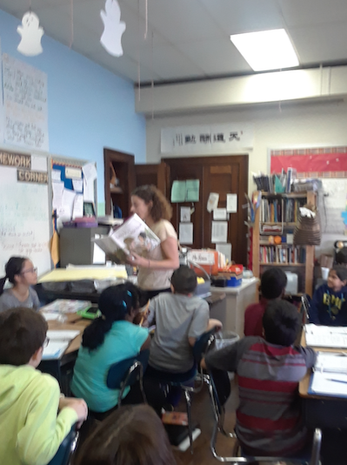
Ms. Romeo reads a PYRCA selection.

Slide 14
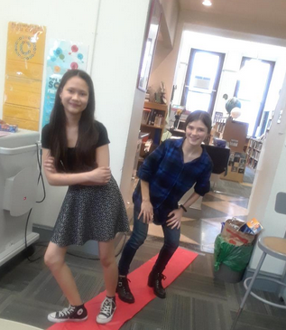
Walking the Red
Carpet to Celebrate
PYRCA Winners

Slide 15
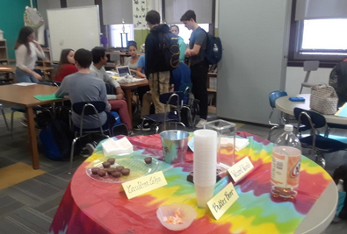
Harry Potter Quizzo

Slide 16
Who knows the answer to this one?

Slide 17
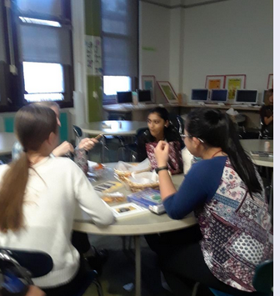
Library Teen Advisory Board

Slide 18
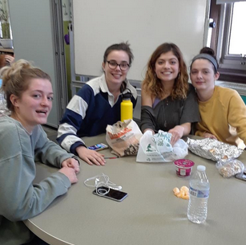

Slide 19
Study, study, study for our exams!

Slide 20
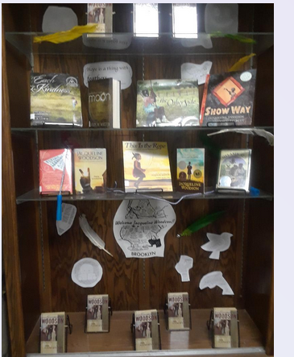
Jacqueline
Woodson
Author Visit
March 1, 2018

Slide 21
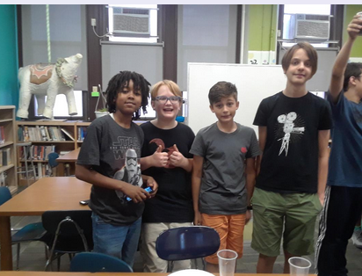
Table Top Games Club Dungeons And Dragons

Slide 22
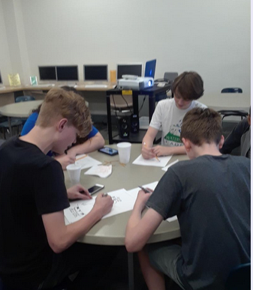
JuReMaCon= for the lover of Manga

Slide 23
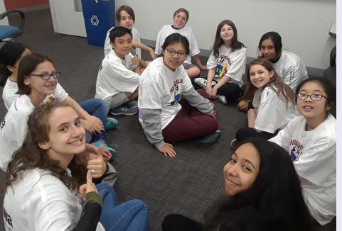
Philadelphia Reading Olympics

Slide 24
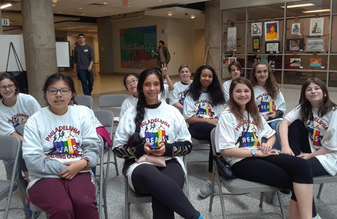
Great Team Wins Blue Ribbon

Slide 25
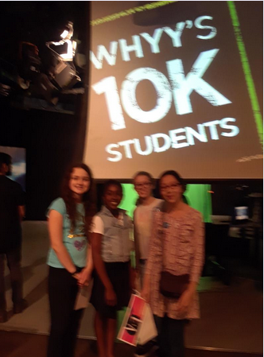
Ink Drinkers visit WHYY.

Slide 26
Annual Ink Drinkers’ Booktalk Breakfast

Slide 27
Ink Drinker Shares History of Book Club

Slide 28
Sorry, no photos for these events:
Intermediate Reading Olympics
Craft Day
Game Day
Take a Book Home for the Holiday
Poetry and Story Slam
Visits from librarians from The Free Library
All the Teen Author Events and the author events the fifth and sixth grades attended through collaboration with The Free Library:
Lauren Tarshis, Andrea Davis Pinkney, Martha Freeman, Amy Ignatow,, Erin Entrada Kelly, Jen Bryant, Carole Boston Weatherford, Ruta Sepetys.

Slide 29
The library is also home to The Writing Center
Our generous volunteers:
Luke Beggy
Rebecca Chen
Vivienne Chen
Annica Chiu
Alyssa Collela
Maranda Duignan
Andrea Gonzalez
Isabella Hargesheimer
Brian Huang
Lucy Lin
Maximo Machado
Kate McDowell
Amina Moussa
Kejdi Mucaj
Anna Nguyen
Jonathan Nottingham
Lily Oni

Slide 30
Top Teen Ten
For the past two years, the Library Teen Advisory Board and other interested student-readers have participated in an American Library Association (ALA) grant to review books for Young Adult Library Services Association. As we come to the end of our grant, we have read and reviewed hundreds of books and our students have received these books to add to their personal libraries. In addition, this spring, the ALA delivered the twenty or so titles of the winning Top Teen Ten choices. These brand new, mostly hardback books are exciting additions to our Young Adult collection.

Slide 31
So please, oh PLEASE, we beg, we pray, Go throw your TV set away, And in its place you can install, A lovely bookshelf on the wall. — Roald Dahl, Charlie and the Chocolate Factory

