Slide 1
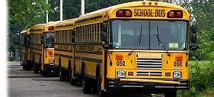
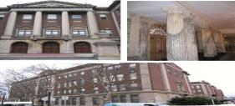
MOJO Refresher Training
Facilities Operations
2019

Slide 2
Objectives
Building Engineer Requests
BEs responsibilities pertaining to the MOJO system
Viewing/sorting your work requests
Creating your own BE request
Posting your time and completing work request
Maintenance Requests
Reasons for rejections/cancellations of maintenance requests
Creating a proper maintenance request
Common MOJO issues
Q&A

Slide 3
Building Engineer Requests

Slide 4
BE responsibilities
Viewing requests the principals have created for you
Performing work issued to you for preventative maintenance such as
Boiler Cleaning
Summer Cleaning
Cooling Tower PM
IEQs
BEs should create a work request for themselves to allow them to enter time for diagnosing and troubleshooting an issue before creating a maintenance work request
Level 2 priorities that must be addressed immediately are an exception to this

Slide 5
Using the “Show” drop down box, select All to ensure you see all work requests for your location
Use the Program ID box to select your school to see all open requests. Clicking on the blue button will bring up the lookup window. You can type in part of the name of your school, hit enter, then select the school from the list.

Slide 6
Engineer requests that have not yet been approved can be found in the Requested category. You have the ability to review the requests or reject with reason noted. You can also see maintenance requests you have created in this cabinet, and edit them until they are approved if necessary
Maintenance requests that have been approved for repair can be found in the Assigned to Work Order category. You will no longer be able to edit, the request, but you can still change the description by clicking on the work description from within the cabinet
Requests issued to you, or maintenance requests that have been scheduled for repair can be found in the Issued and In Process category. You have the ability to review and complete your work from this cabinet
Any completed BE and maintenance requests will show up in the completed cabinet for up to 90 days. You can still reissue a completed maintenance request if work was not actually completed along with a note stating why

Slide 7
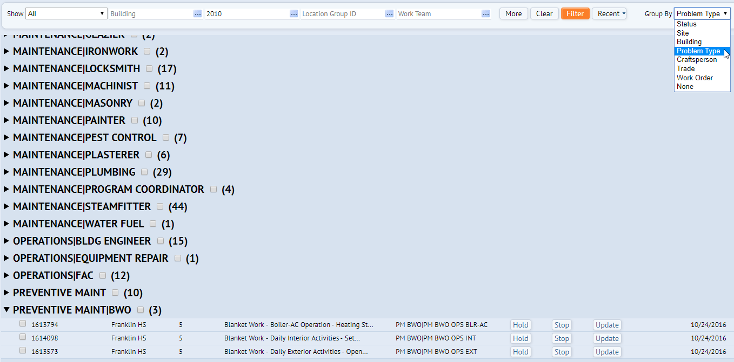
Use the “Group By” drop down box to select Problem Type to sort your work request by Department and Trade
Work requests are now sorted by department and trade to allow for simpler sorting and viewing
Work requests can also be located in the OPERATIONS BLDG ENGINEER category regardless of status of approval
The new blanket work orders can be found in the “PREVENTATIVE MAINT|BWO” category

Slide 8
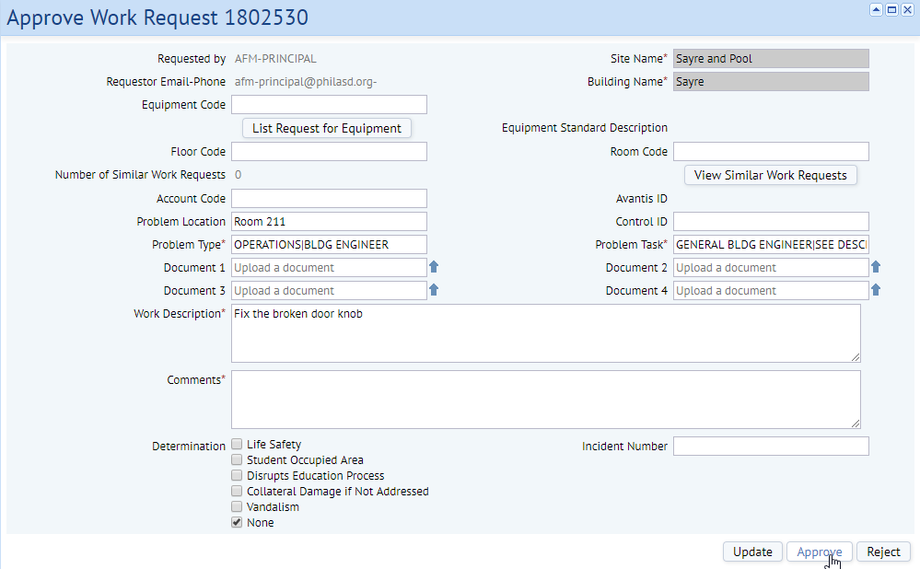
Principals can make requests to the building engineer for repairs. To approve or reject these requests, simply click the Approve button.
A window will pop up where you can either approve the request or reject it. If you reject it, you will need to provide an explanation why in the comments section.

Slide 9
Posting Your Time
All BEs must post 8 hours of time for each day for a total of 40 hours per week
Time should be posted to specific work requests. You can use an existing work request or if necessary create a new work request
There are 3 blanket work orders which are to be used for specific daily routine tasks
Boiler/AC plant operation
Daily exterior activities
Daily interior activities

Slide 10
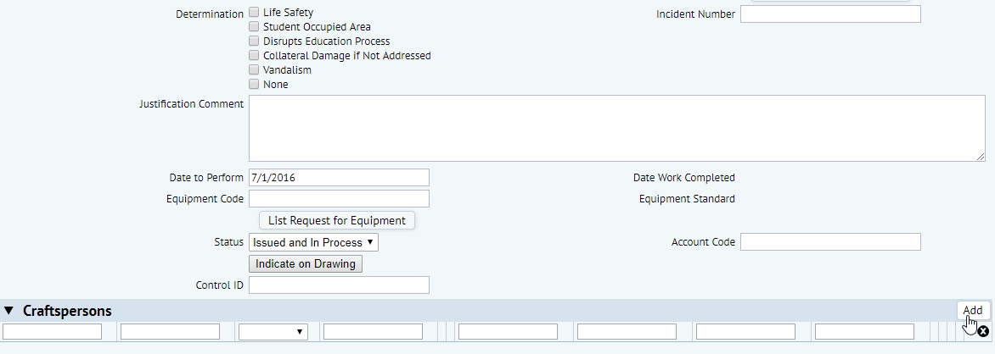
Open a request in your issued cabinet. You can look for requests specifically assigned to you by filtering by the BLDG ENGINEER trade in the top field. If you’re looking for your blanket requests, filter also for priority 5.
To post time your time to a work request, scroll down after opening the request until you see the Craftspersons line, and click the add button to the right. If you do not see this add button, contact MOJO support

Slide 11
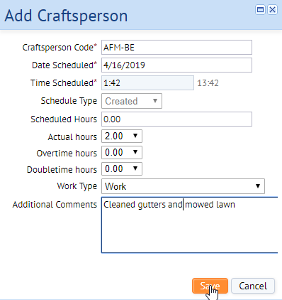
A window will pop up and you can look up your name, put in the date you worked, the amount of hours worked in the “Actual Hours” field, then any comments you want to add, and then click Save.
The line will be displayed, showing the information you entered. If you made a mistake, you can either edit the line by clicking on the line, or by scrolling to the right and clicking on the X.
After you enter your hours, and the request is not a blanket request, you can complete the request and remove it from your cabinet. Filter your requests, click the complete button, and click Yes

Slide 12
If you need to create a request for yourself, click the “Report a Problem” button, but when you scroll down to the Problem Type and Task, select Operations, then Building engineer, and then the problem tasks associated with the repair you performed. After the request is created, you can edit it, add your hours, and then complete it like any other request assigned to you.
You can still add time or attachments to a request 90 days after completion. If repairs could not be made, you can make a maintenance request by either creating a new one from scratch, or opening one of your existing requests and clicking on the “Duplicate” or “Create Maintenance” request. Just make sure to change the Problem Type and Problem Tasks to the correct trade and issue

Slide 13
Reissuing a Completed Request
Any request made can be reissued by the person who created the original request
This helps in opening up a request that was completed when either
work wasn’t performed
work was performed, but the problem occured again immediately after the mechanic left
the request was completed accidentally when actually a return trip was needed

Slide 14
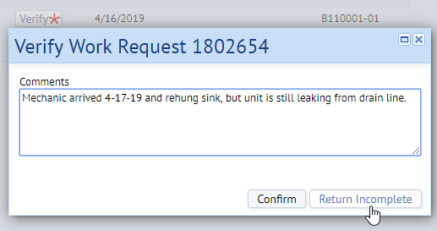
To reissue a request, search through your dashboard and find the request that was completed. You can either click on the “Verify” button to the right, or selecting the checkbox of the request and clicking the Verify button that appears at the top.
A window will appear where you can add your comments on why the request is not complete and needs to still be addressed. Click on the “Return Incomplete” button, and the request will not show up in the Issued and In Process status group

Slide 15
Printing a Work Request Report
The open/closed search report can provide an easy way to see all of your requests regardless of whether they’re open, closed, or canceled
You can’t perform any other actions to the results like you can in the building operations console, but you can print the results and export them to an excel document

Slide 16
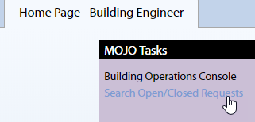
Go to your home page, and instead of clicking on Building Operations Console, instead click on Search Open/Closed Requests
You will have a form with many fields, similar to the building operations console. You can select multiple filters, but if you want to specifically look for requests for your building for maintenance, you can select MAINTENANCE from the Problem Type 1 drop down box, and then search for the school using the Building field. After you are done, click the Show button in the upper right.

Slide 17
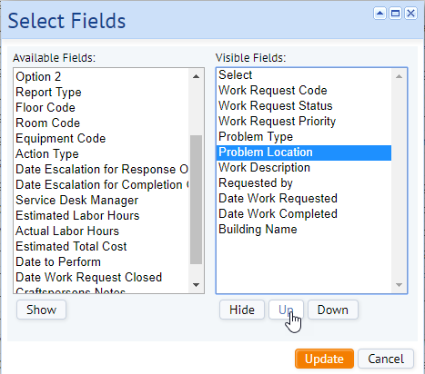
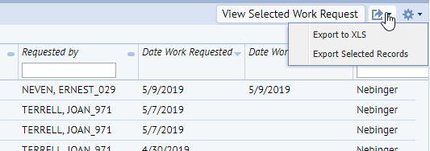
You’ll be able to see the results of the search in a listed format. You can select which fields you want to display by clicking on the gear in the upper right, then clicking “Select Work Request Fields.
A window will appear and you can switch between which fields are available, and which you want to show, as well as arrange them in order. Top to bottom will display them from left to right on the results screen.
To print the report, click on the icon in the upper right that looks like a box with an arrow, and then click on Export to XLS. You’ll then be able to select where to save the document on your computer. You will still need to edit the spreadsheet to make it print how you want it.

Slide 18
Maintenance Requests

Slide 19
Requests outside of MOJO
Public address systems, landline phones and voice over IP phones are no longer a work request issue, contact 215-400-5567 for all repairs
Security systems, cameras and Aiphones are not a work request issue, contact Eric Rosa at 215-400-4710 for all repairs
Requests for elevator keys need to be made by directly calling Michael Krajewski at (267) 336-6081. These are no longer a MOJO request
Repairs to server room HVAC units should go through the IT help desk 215-400-5555, specifying the ticket be assigned to Marta Mackiewicz. IT has a contact with a vendor for repairs

Slide 20
Priorities
Level 2 work requests are for emergencies only including but not limited to fire alarms, elevators, bed bugs, main drains, and exterior lighting
The FAC must be contacted either by phone, voicemail, email, or text when a level 2 is submitted. The work request must specify which FAC was contacted and how. Any level 2 requests that do not have this information will be changed to a level 3.
Level 3 work requests that have not been addressed after a long period of time should be reported to the FAC for escalation. After approval, requests are determined by the scheduler when work will proceed. Your FAC will escalate the request if necessary

Slide 21
Common reasons for rejections
Building Improvement Forms (BIFs) are required for any new installation or large repair/project. Request for these types of repairs/projects entered into MOJO will be rejected. Examples include:
Installation of new/additional fixtures
Rewiring and relocation of existing fixtures
Upgrading/downgrading electrical outlets
Installation and wiring of interactive boards
Installation of any whiteboards/corkboards
Capital Projects used for larger renovations
Whole parking lot needs resurfacing
Entire room renovation

Slide 22
Common reasons for rejections
Duplicates
It is the BEs responsibility to check their cabinet to look for requests are already submitted in the past either by themselves, a CA, a BE trainee, or a previous building engineer
If a request is still assigned or issued, creating a second request will be rejected and will not get the work done faster. Instead, contact your FAC to escalate the existing request already in the system
If a request is for a second unit with the same unit in the same location, it must be specified somewhere “this is for unit #1” “this is for unit #2”, so as to differentiate

Slide 23
Common reasons for rejections
Not enough information
Complete description of issue
Location and landmarks
Size / Quantity
What work the BE has performed to correct the issue before making the request

Slide 24
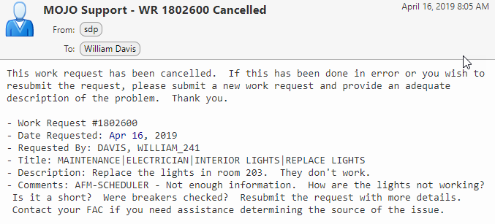
Example Rejection Email
Shows the username of the person rejecting or canceling the request
Describes the problem with the request and further steps if necessary

Slide 25
Info to include on work requests
Detailed description of the issue
FAC name and contact method for level 2 requests
Specify landmarks for the location of the issue
Specify the fixture number (left to right), e.g. toilet, elevator, pump, univent, etc
Specify size of the problem, either linear feet, square footage, quantity, etc

Slide 26
Info to include on work requests (cont.)
If the mechanics / foreman / scheduler are currently in the building, and the name of person asking you to put in a request
Specify all actions that you have taken to resolve the issue, prevent further damage, and safety precautions taken
Include documents or photos if possible
If unable to add, email the files to mojoproject@philasd.org and put the number of the work request in the subject line

Slide 27
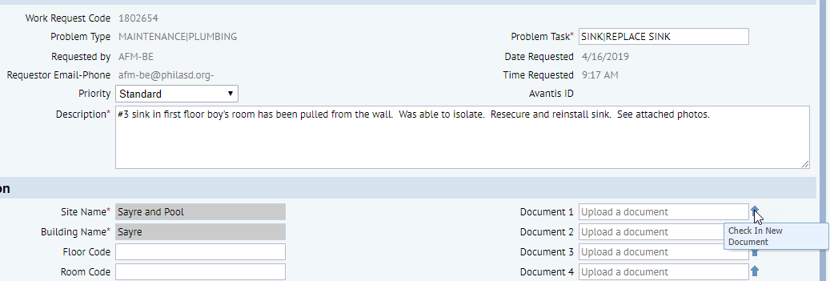
Attaching a file to a request
You can’t attach a document when you first create a work request, but you can open an existing request and attach it later. To do this, create a request, filter for your requests, and then click the work request number, or the update button for that request you just made.
With the work request open, you’ll see 4 document fields. Click on the arrow next to one of them.

Slide 28
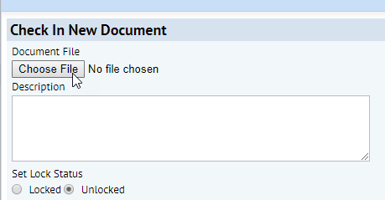
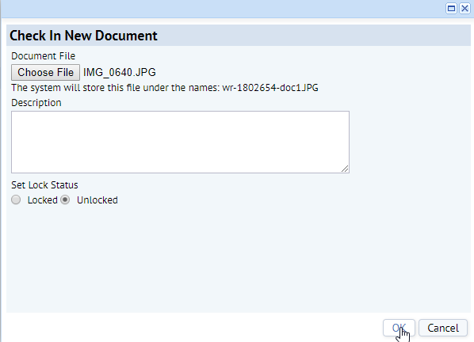
Attaching a file to a request
After you select the file, you’ll see the name of the file you chose. Now click on OK
Another window will appear. Click on the choose file button, and then search your computer for the document you want to attach. It can be a Word, Excel, PDF, or an image file.
Your file is now attached. You can also edit the description above to state you attached files to the request.

Slide 29
Example of a bad request
Floor is specified but no landmarks. There could be 3 fountains on this floor.
Description is too short. Doesn’t specify what the exact issue is. Most issues are plumbing related, but the BE chose the electricians trade. Does this mean it’s an issue with the receptacle? BE also didn’t state if this is a safety issue, if it’s been isolated, what work has been performed to resolve the issue. This request would be rejected

Slide 30
Example of a good request
Specifies exact location in the school
Details precautionary measures taken
Describes the repair needed
Describes the location of the unit in the room
Describes the exact issue with the unit

Slide 31
Trade specific issues
Any repairs to Boilers MUST be relayed to your FAC to investigate. These requests will be rejected
Any repairs to Chillers, cooling towers and large AHUs must now be relayed to your FAC to investigate. These requests will be rejected
Equipment repairs (lawnmowers, scrubbing machines, etc) must include the make/model/serial/PSD ID tag number. If this information cannot be found, or the equipment was already taken, then specify so on the request

Slide 32
Trade specific issues
Glass department
Inventories of glass are no longer supplied. A request must be made with all locations specified in the description. Glass requests without locations specified will be rejected
Size, type, interior/exterior must be specified, and an incident number supplied if it was due to vandalism

Slide 33
Trade specific issues
Lighting
120v receptacles and ballasts are the responsibility of the BE
Specify type of ballast and ensure ballasts have been ordered and on site
All exterior lighting is a level 2 and your FAC should be notified
Specify exact number, type, location, and height of exterior lights, and if a cherry picker is needed
Do no include more than 4 light repairs on a single work request
Bulbs, clips, covers are provided by the FAC and not a maintenance request

Slide 34
Trade specific issues
Doors
Specify interior or exterior and material (metal or wood)
Specify whether or not the exterior door can be secured with slide bolt
Any requests for BEST keys require contacting your FAC immediately and an incident report created. Create a level 2 and note the incident number on the request

Slide 35
Trade specific issues
Carpentry, Plaster, Painting, Ironwork, Masonry
Accurately describe the damaged material (wood, stone, marble, aluminum, plaster, etc.) and also the material it is installed on
Iron railing installed into cement stairs
Wood cabinet installed on concrete block wall
Specify the color of the tile to be replaced
Any leaks must first be addressed by another trade. Only enter requests for repairs after the source of the leak has been repaired first. If there was a leak, you must specify that it has been repaired

Slide 36
Trade specific issues
Pest Control
Bed bugs
Require a sample or a clear photo. Requests without a sample will be rejected
Time of room availability, or ability to relocate students upon visit, must be noted so the mechanics know when to service
Mice/Roaches/Waterbugs
One work request must be made for each floor with a list of the rooms in the description where evidence of pets have been found
Pest control does not supply an inventory of traps. These requests will be rejected
Pest control will only trap live animals
Pest control does not service for lice

Slide 37
Trade specific issues
Plumbing / Steamfitting
Size / length / type / material of the pipe
e.g. 4LF of 2” copper hot water return line
Has leak been isolated / clamped?
Is it a safety issue? i.e. leaking burning steam / hot water
Is there asbestos insulation on the fixture?
If unknown, contact FAC or check the online ahera reports
If yes, a request should be made to environmental to remove

Slide 38
Trade specific issues
Environmental
Before entering a request for environmental use the link AHERA Environmental Data to check the environmental conditions in your school
If you are unsure of materials or issues and you are creating a work request for environmental, your FAC MUST be contacted
If entering a request for carpenters to install tile removed by environmental, specify that they have already removed

Slide 39
Common MOJO issues
Only logo showing up on screen
Refresh the page
Can’t see specific requests
Check to make sure your filters are set properly (e.g. by program ID)
There is an issue when fields are changed, the priority level changes back to a 3. Check your priority level last before submitting the request
Contact MOJO Support for the following
Building is different than where BE is currently assigned
Can’t enter work requests
Can’t log in
Can’t enter time on their own requests
MOJO Email : mojoproject@philasd.org
MOJO Phone : 215-400-5555 option 5
MOJO Support Website : mojoproject.philasd.org

