Slide 1
Writing In An Elementary Classroom
Christine Del Rossi
ESOL Teacher- Frances E. Willard Elementary School
capayne@philasd.org
Notes:
Hi and Welcome! My name is Chrissy Del Rossi. I am in ESOL teacher at Willard Elementary. I work in the 1st and 2nd grade ESOL friendly classes in my school. I am here to talk to you today because I love working with kids and teaching them how to write. I want my students to have the same passion for writing that I do. How many have experienced the moment when you announce to the class that it is time to write an informative essay and the whole class groans?
PAUSE
Lucy Calkins discusses this very moment on Page 13 in The Art of Teaching Writing. When we see the look of resistance on our student’s faces when writing is to begin, it is not there because writing is inherently a dreaded activity, but because writing has been taught in ways that make it so.
It is my professional mission to overcome that dread and help my student’s develop a passion or at least the motivation or desire to write and for them to be successful as writers. I want to share with you how we go about doing that at my school.

Slide 2
Kid Writing
http://kidwriting.homestead.com/Index.html
Notes:
It is important for all teachers to understand how kids learn how to write. My first 3 years of teaching I worked as a Balanced Literacy Intern teacher at Crossan Elementary and worked in the kindergarten classrooms. I observed and learned firsthand how kids learn to write. We used the Kid Writing approach to develop and teach this process.
Kid Writing- A Systematic Approach to Phonics, Journals, and Writing Workshop is written by Eileen Feldgus and Isabell Cardonick and is an amazing resource on understanding how kids learn to write initially and how to teach them. They also have a website listed you can also access.
The best part of this approach and why kids love to do it and not groan or resist when we say it is time to write is that it is based on the kids and what they want to write about and the skills they need to learn.
EXPLAIN PROCESS-
We show the students how to draw a picture with lots of details and colors. They draw pictures about whatever they want. Then, you work 1:1 with the child to write their story about their picture. You sit with an alphabet chart and will have to help sound out the words by stretching the word. You accept whatever the student is able to do. In the beginning they do a wide range of things. They may need a magic line because they can’t hear any sounds to hold the place for that word. They may hear one sound and write the wrong letter. They may hear some sounds and can identify the letter. At this point, you are the child’s coach, not the teacher. You are encouraging all and anything they are doing. You begin to build their confidence as writers. The work they do we call and distinguish for the students as Kid Writing. When they are finished and we point out all the great and smart things they did in their writing, it is time for the Adult writing. This is when we get the opportunity to be their teacher and meet their individual needs. We model how adults would write the same sentence or story depending on the level of the child.
The second phase of this approach is the mini lesson. We use a child’s journal to teach the class a skill they need. For example, the might need to learn how to space, put a period at the end of a sentence, continue to learn how to stretch out words, use sight words, etc. The child comes to the front of the class and shows their picture and story and reads it to the class (with help if necessary). The class can ask questions about the story or picture (also makes for great mini lessons on how to ask and answer questions). Teacher and or class points all or at least 1 great skill the student was able to do in their writing. You have to identify something. Then , we say we are going to use this journal to help teach the class
something new about writing so we can all become better writers……at the everyone claps and thanks student!
SHOW Jake’s journal…….SHOW Octopus book…….website also has other great examples…..

Slide 3
Webinar
Multilingual Website: http://webgui.phila.k12.pa.us/offices/m/multilingual-education
Under Professional Development: Informational Videos/Presentations
Select Writing Portfolios- Elementary School
Notes:
The Kid Writing is great for kindergarten and beginning students (whatever grade they may be in). I get 2nd graders who do not speak (therefore don’t write) in English. However, they also have limited experience writing and reading in their own language. I work in a small group with these students using Kid Writing.
As students get into older grades, this process starts to look different and we create a writing workshop in our ESOL friendly classes. In writing workshop, I still maintain and utilize the same techniques from Kid Writing, I just start adapting to meet the needs and levels of where the students are at in the higher grades. This can also range greatly throughout the class. Now, they need to start learning skills about voice and style, focus, organization, editing skills, etc into their writing. I still want them to have that love of writing and motivation to do it. The focus should still be on what the student wants to write about.
Now, we start working on the writing process. We are going to watch a webinar I created that is posted on the multilingual website. It is under professional development, under informational videos/presentations. This webinar is about 4 minutes and explains the next process of writing with students in an elementary class. Max Klink use to be a first grade teacher a few years ago at our school. He did a PD for our teachers explaining how he used this process in his class. For this webinar, the students are working on a specific project.
The book 50 Strategies for Teaching English Language Learners also talks about this process on page 203.
PLAY WEBINAR
(4 MINUTES)

Slide 4
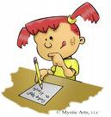
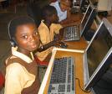
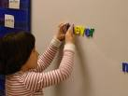
The Daily 5 http://www.the2sisters.com/the_daily_5.html
Notes:
The next aspect of what we do in our ESOL friendly classrooms is the Daily 5. This is a system to structure and manage the literacy block to allow productive time for the authentic independent practice of writing (and reading). Research shows that this is crucial for success in writing and reading.
This system and book explains from Day 1 how to start training the students how to work independently in 5 different choice activities. The children work in the first 6 weeks of school to build their stamina and be able to work independently for a period of time of 20-40 minutes for students in K-6.
They do Read to Self; Read To Someone; Work on Writing; Listen to Reading; and Word Work. This book explains step by step how to teach this to children. It is a very easy read.
Once this system is up and running…..It allows time for the teacher and in our case both teachers (because we coteach) to pull small groups of students or individual students to work on guided reading/writing. We conduct mini lessons for the whole class in between each session on skills the students need or what the Core indicates. This is differentiating instruction because we can write and read with a group of students based on the needs they have or the skills they are lacking.
At the same, this helps with one of the biggest challenges of writing workshop……classroom management. Teachers always struggle, I have always struggled with…..
WHAT DO WE DO WITH 29 OTHER STUDENTS WHEN WE HAVE TO CONFERENCE WITH 1 AND WORK WITH EACH OF THEM? Daily 5 is the solution to this challenge and problem.
Our ESOL friendly classes in 1st-3rd have been working with this model for about 3 years and have had great success.

Slide 5
Balanced Literacy
Notes:
As an intern teacher, I was trained and worked through the Balanced Literacy model which I believe creates the appropriate environment for delivering effective and authentic writing and reading instruction. This model is based on this wheel. All the pieces of the wheel should be incorporated into instruction everyday throughout the day and throughout the curriculum. This also lends itself to differentiated instruction because you are working with the whole group, small groups, and individual students. This is very important for our ESOL students because they need the time and attention to develop the language and skills they need to be successful in writing and all subjects.

Slide 6
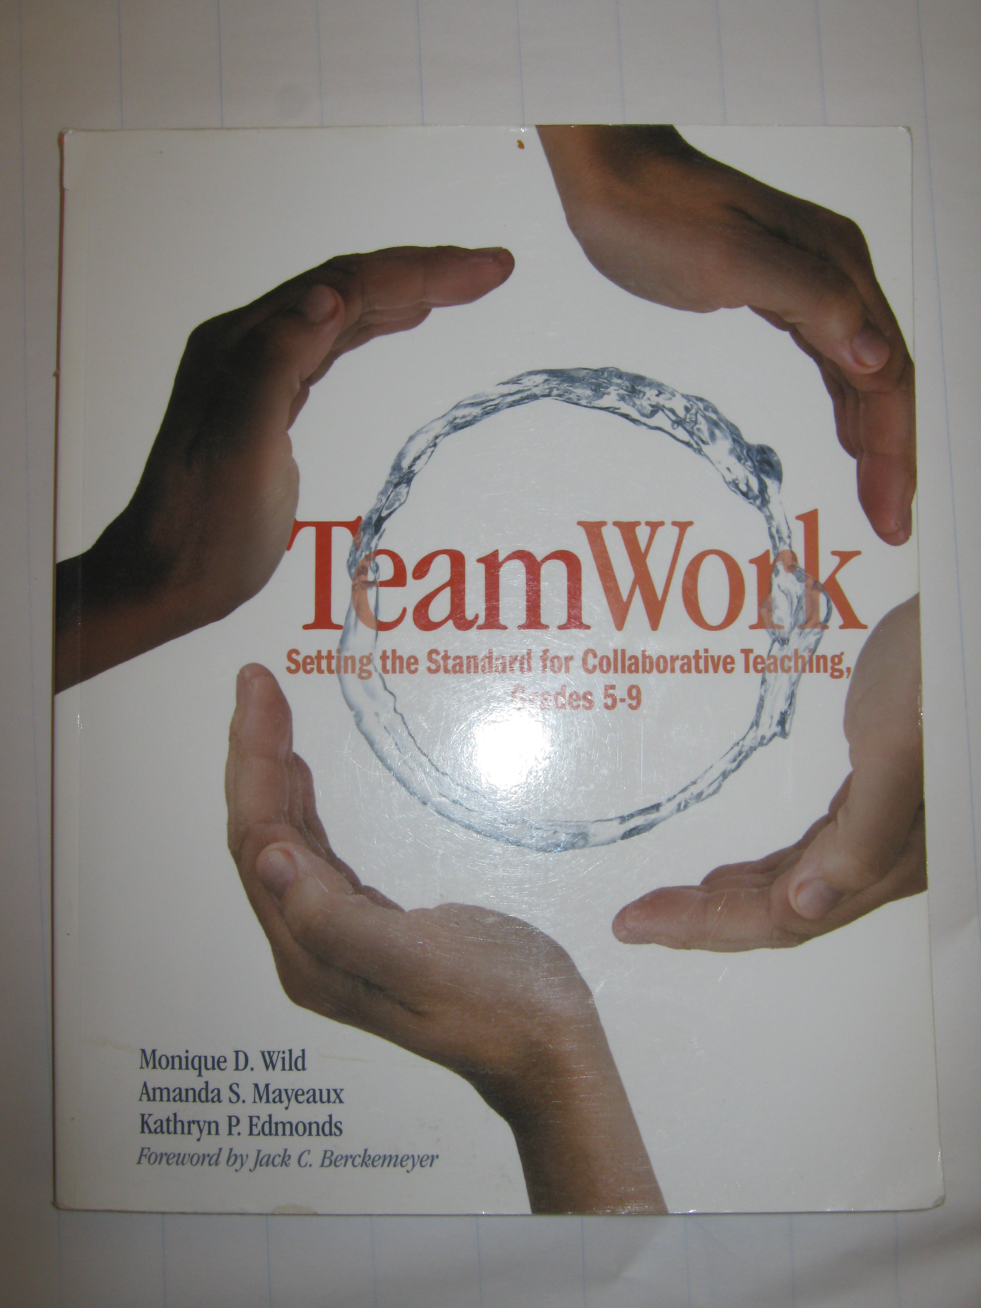
Collaboration
Notes:
The key for making all this work at our school is the fact that we collaborate extensively with our teachers by pushing into the classrooms during the literacy block. We become co-teachers when we enter the class. I started teaching this way and am grateful to be able to continue this style of teaching at Willard.
Collaboration is hard and has its challenges. I took a Collaboration course during my Masters program at University of Turabo. We used this text, TeamWork. It written by middle school teachers, however the content and ideas were still applicable and beneficial for what we do at Willard.

Slide 7
Tools
Alphabet charts
Writing Tool Kit
Anchor Charts
CLI Compass website: http://www.clicompass.org/sites/clicompass/pages/mydashboard.aspx
Notes:
Here are some tools I find useful…..
I use various alphabet charts with small groups and individual students for both writing and reading. SHOW THEM!
Our ESOL team of both ESOL and classroom teachers created this Writing Tool Kit for the students. We have and continue to have mini lessons on how to use each page. They keep this in their desk to use during writing. These are valuable to the students. We had a second grader move back to Puerto Rico. On her last day we were dismissing her and saying our good byes in the school yard. She remembered she left her writing tool kit in her desk. She had to go back for it….because she couldn’t move back to Puerto Rico without her writing tool kit!
Anchor charts are used and explained in Daily 5. They can look like this. They can also be used for whatever skill or mini lesson you have done with students. They should be posted for students to access when working independently. We came across the CLI Compass website recently in a PD. It is a free website with tons of valuable information to help improve teaching practices. This is geared for K-3 teachers. It also talks about anchor charts. It is more geared towards reading at this point, but is a work in progress. I encourage people to check it out.

Slide 8
Projects
Class Books:
* Digital Story Books-http://podcast.phila.k12.pa.us/
* Published Book- http://www.studentreasures.com
* ABC Book
* Important Book
* Cook Book
* Riddle Book
Notes:
Writing is a process. It is developmental. It needs to be taught through authentic, meaningful ways. I really enjoy reading what my students have to say. Everyone has a story to share. Because of all this work and collaboration we are able to work on some creative projects with our classes that students enjoy…..
Digital Story Books- Because of all the work we do we are able to create digital stories with our students. Examples of these can be accessed on the podcast site of the SDP. The Important Book I talked about in the webinar we made into a class book this year. This is on the podcast site.
When I worked as an Intern, the kindergarten and first classes published a book. The students were able to purchase a copy. The website for that company is listed.
This is an ABC Book made by a first grade ESOL friendly class.
This was a Cook Book that was made by kindergarten students when I was an Intern.

Slide 9
Let’s Talk Writing
Willard student podcast
Notes:
Show podcast if finished! Let’s hear what the students have to say about writing……

Slide 10
Questions/Comments
* My email information: capayne@philasd.org
????
Notes:
Here is my email if anyone has any questions or concerns.

Slide 11
Bibliography
Boushey, G. & Moser, J. 2006. The daily 5: Fostering Literacy Independence in the Elementary Grades. Portland: Stenhouse Publishers.
Calkins, L. 1994. The Art of Teaching Writing. Portsmouth: Heinemann.
Feldgus, E. & Cardonick, I. 1999. Kid Writing: A Systematic Approach to Phonics, Journals, and Writing Workshop. Bothell: The Wright Group.
Herrell, A. & Jordan, M. 2008. 50 Strategies for Teaching English Language Learners. Upper Saddle River: Pearson.
Wild, M., Mayeaux, A., & Edmonds, K. 2008. TeamWork: Setting the Standard for Collaborative Teaching, Grades 5-9. Portland: Stenhouse Publishers.

