Slide 1
RICHMOND SCHOOL
Annual Title I Meeting
September 23, 2020

Slide 2
WHAT IS TITLE I?
The federal government provides Title I funding to states each year. These funds are disseminated to each School District (LEA). The District is then responsible for distributing these funds to all our schools based on two criteria:
Formula based on low-income status
Title I School Designation
Each Spring during the budget process, our school decides how best to use our Title I funds based on a needs assessment with the guidance of school leadership, parents and community members.

Slide 3
OUR SCHOOL NEEDS YOUR HELP EACH SPRING TO WORK WITH SCHOOL STAFF AND DEVELOP:
The Parent and Family Engagement Policy
The School-Parent Compact
The Schoolwide Plan
The School Budget

Slide 4
SCHOOL DISTRICT OF PHILADELPHIA PARENT AND FAMILY ENGAGEMENT POLICY
The School District of Philadelphia, with the input of parents, develops a written, district-wide Parent and Family Engagement Policy.
If you are interested in providing suggestions and/or recommendations at the District level, please contact your school’s Family Engagement Liaison or the Office of Family and Community Engagement (215-400-4180).
Notes:
⇢
Title I provides additional funding to schools to help close the achievement gap through a well-rounded education. All Philadelphia public schools are Schoolwide Title I schools, meaning all students are Title I eligible. Because all schools are Title I buildings, all are required to have Parent and Family Engagement opportunities.

Slide 5
SCHOOL-BASED
PARENT AND FAMILY ENGAGEMENT POLICY
Discusses how:
We will involve parents in the process of school review and improvement
We will provide the necessary technical assistance to parents that will support and improve student academic achievement
We will build parents’ capacity for strong parental involvement to improve student academic achievement
Parents are involved in the development, evaluation and revision of the Parent and Family Engagement Policy

Slide 6
SCHOOL-PARENT COMPACT
The Compact states the goals and responsibilities of the school in providing a quality education to all students and identifying interventions for students who are struggling academically.
The Compact states the responsibilities of parents and students in helping the school to meet these goals.

Slide 7
TITLE I SCHOOL DESIGNATIONS
In Pennsylvania, all schools are given a designation of Comprehensive Support and Improvement (CSI), Targeted Support and Improvement (TSI), Additional Targeted Support & Improvement (ATSI) or Non-Designated, based on school performance measures:
These include the state’s academic standards and assessments (PSSA/Keystones)
Our School Designation is: A-TSI

Slide 8
SCHOOLWIDE PLAN
The Schoolwide Plan is the school’s roadmap to academic success. It details:
Where the school is now (data)
Where the school needs to go (goals)
How the school will get there (plan)
How the school will know if the plan is working (review and revise)

Slide 9
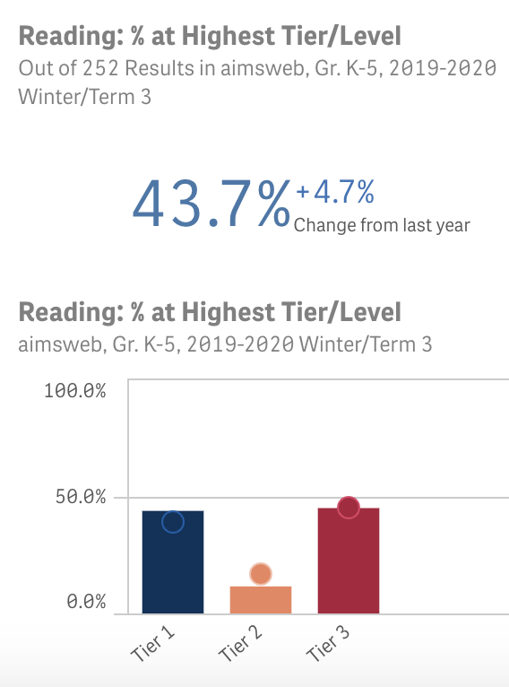
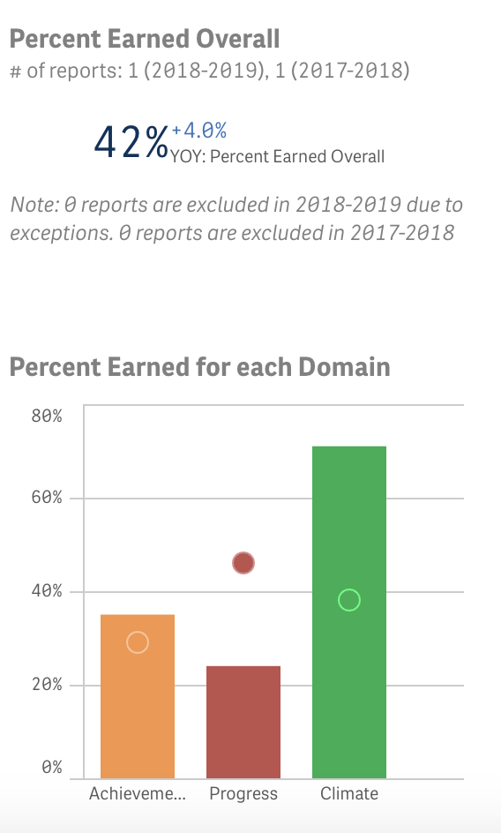
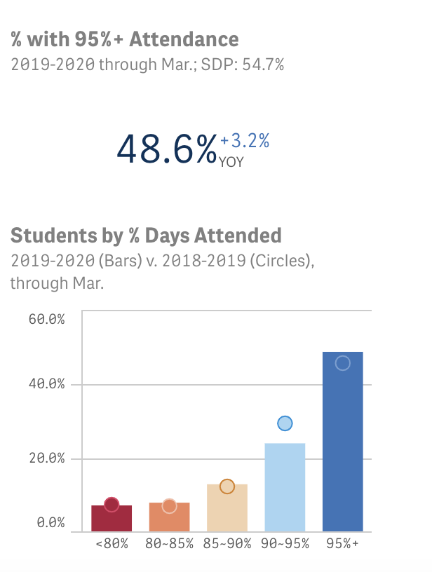
OUR DATA

Slide 10
SCHOOLWIDE PLAN
OUR GOALS
Mathematics: At least 30% of students in grades 4 and 5 will score Proficient or Advanced on the Math PSSA.
Mathematics: No more than 23% of 3rd grade students will score at Below Basic on the Math PSSA.
English Language Arts: At least 62% of students in grades K-3 will score at Tier 1 by Spring Aimsweb Assessment, as evidenced by the grade level composite score.
English Language Arts: At least 50% of students in grades 4-5 will score at Proficient or Advanced on the ELA PSSA.
Student Attendance: At least 51% of students will attend 95% of days or more.

Slide 11
SCHOOLWIDE PLAN
OUR APPROACHES
Strategies and Action Steps for Math:
*Mathematical Tasks that address Conceptual, Procedural, and Applied Understanding
*Math Block Scheduling
*Improving Standards Aligned Instruction through PD & Weekly CPT Meetings
*Data Driven Instruction
Strategies and Action Steps for Literacy:
*Holistic Literacy Instruction for all students *Small Group Instruction
*Blended Learning using Lexia
*Teacher Questioning to understand students’ strategies,
*Facilitate connections, and use mistakes for learning.
Strategies and Action Steps for Attendance:
*PBIS *Targeted Attendance Interventions

Slide 12
SCHOOL BUDGETS AND SET-ASIDE REQUIREMENTS
Title I expenditures must support the school’s core academic program to ensure a well-rounded education. They should be aligned with the Schoolwide Plan.
Parents must be involved in the discussions regarding how these funds will best support improving academic achievement.
1% set aside for Parent and Family Engagement
Parents must be involved in the discussions regarding how these funds will best support them in working with their child at home to improve achievement.
Notes:
↵

Slide 13
SCHOOL TITLE I SPENDING
Our School plans to spend this year’s Title I funds on… purchasing 2 teachers: SBTL & Intervention Teacher
Our School plans to spend this year’s Parent funds on…
Purchasing books for an at home library

Slide 14
PARENT AND FAMILY ENGAGEMENT ACTIVITIES
Our Planned Parent Engagement Activities for the coming year include…
Parent Workshops on Student Attendance, Parent Portal, Volunteer Orientation, Growth Mindset, Crayola Writing
Join our SAC (School Advisory Committee)
Meetings are held monthly

Slide 15
TEACHER & PARAPROFESSIONAL QUALIFICATIONS
Appropriately State Certified Teachers:
Certified by passing state examination (PRAXIS)
BA degree
Area of certification must match the teaching assignment
To be hired, all paraprofessionals must be Appropriately State Certified:
Completed two years of higher education study, OR
Hold an Associate Degree, OR
Pass a rigorous, formal assessment

Slide 16
RIGHT TO KNOW QUALIFICATIONS
You have the right to request the qualifications of your child’s teacher and any instructional paraprofessionals that work with your child.
To learn the qualifications of these staff members, please make an appointment with the principal.

Slide 17
RIGHT TO KNOW 4 WEEK LETTER
You will be notified in writing when your child is taught for 4 or more consecutive weeks by a teacher who is not Appropriately State Certified.

Slide 18
STATE ACADEMIC STANDARDS AND ASSESSMENTS
Our State Assessments are…
PSSA Literacy & Math: Grade 3, 4, 5
PSSA Science: Grade 4
During report card conferences your child’s teacher will discuss the State’s academic content standards. These conferences will be held on…November 23, 24, 25.

Slide 19
CURRICULUM
Our school’s curriculum is…
Ready Gen for Literacy
Math Expressions for Math
You can support student learning at home.
Ensure that students are logged on each day by
8:30 am and that they attend every day.

Slide 20
OUR SCHOOL NEEDS YOU!
Learn about our Title I program and review documents in our Title I binder located in the main office (available by request during closure)
Take advantage of what Title I has to offer
Get involved in your child’s education
You, your child, and our school can be a winning team!
Notes:
↔⇣

