Slide 1
2019-2020 Senior Exit Surveys
Instructions & Student Portal View
Contact:
seniorexitsurveys@philasd.org

Slide 2
When 12th graders log into the Student Portal (https://sso.philasd.org), they are redirected to Infinite Campus. Their default page is their schedule and assignments for the day.

Slide 3
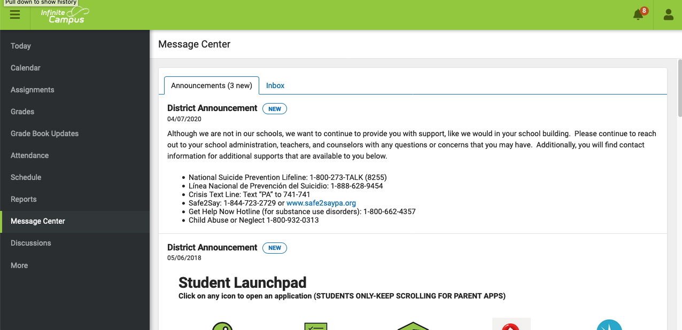
Students must click the “Message Center” menu item on the left

Slide 4
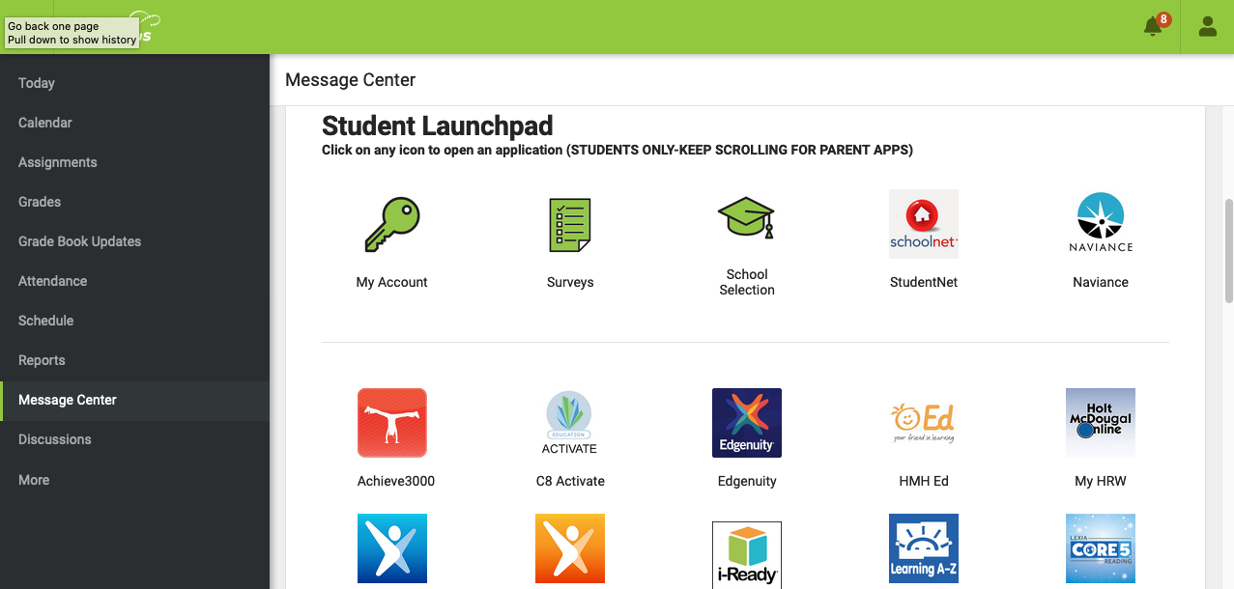
Within “Message Center,” students will see a list of icons (see “Student Launchpad” below)

Slide 5
Students must then click the “Surveys” icon.

Slide 6
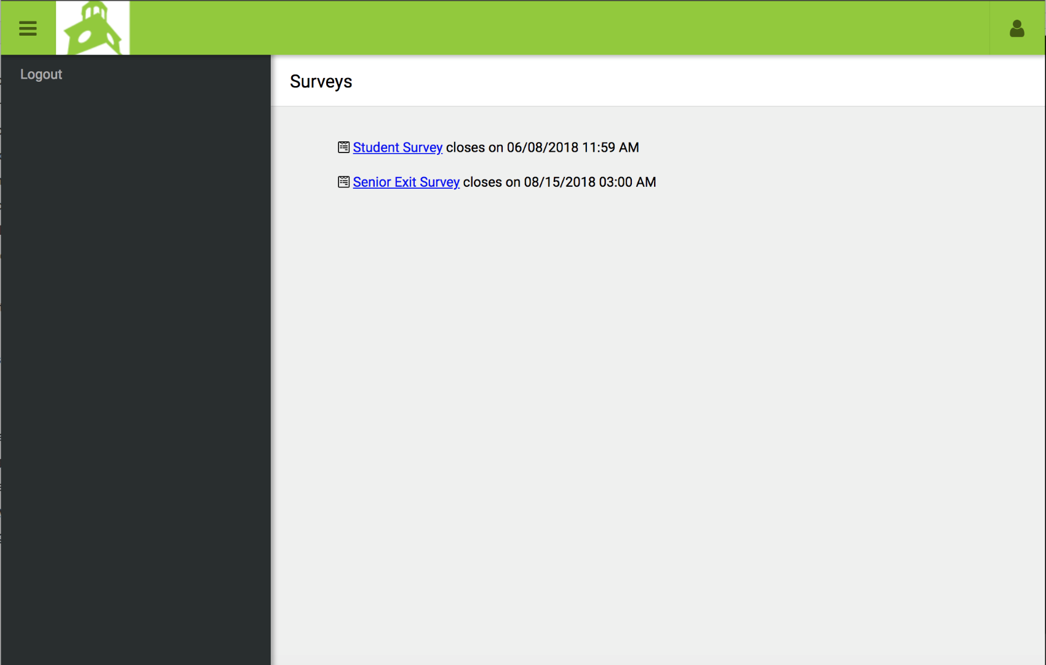
Senior Exit Survey: The “Senior Exit Survey” link will redirect students to Survey Monkey to complete the Senior Exit Survey.
*Will only be available for students in grade 12, and actual date will be during 2020 **Students graduating from the Educational Options Program (EOP) will not see the Senior Exit Survey. The EOP exit survey is administered directly by counselors.

