Slide 1
TRANSITION MEETING

Slide 2
WELCOME
TO THE
SCHOOL DISTRICT OF PHILADELPHIA

Slide 3
AGENDA
Welcome
Elwyn – Intent to Register
How to Locate Your Neighborhood School
Kindergarten Registration Process
Parent Transition Information
Notice of Transition Options
Review of the Special Education Process
Review Evaluation Process including Bi-lingual Evaluations
General Overview-Related Services
Review of Programs in the District and Continuum of Service
Elwyn Contact Information
Q & A

Slide 4
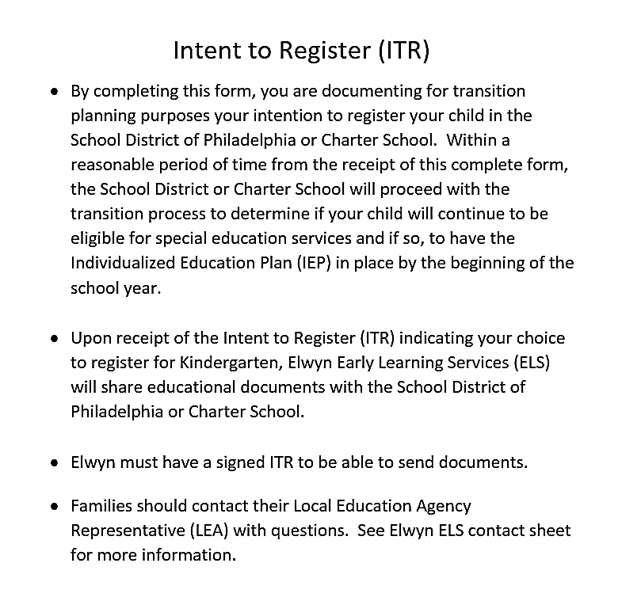

Slide 5
How to locate your neighborhood school:
Navigate to the Districts website: philasd.org
Move your curser over the word “Schools”
Locate and Click on “Find My School”

Slide 6
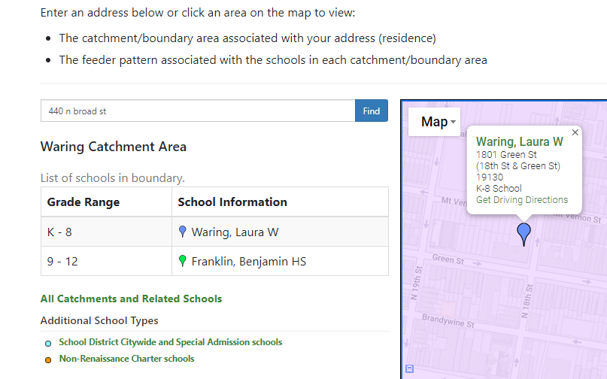
How to locate your neighborhood school:
Type in your address and click on “Find”
Your neighborhood elementary school will be the one for Grade Range “K”
If you click on the icon that matches the color of the elementary school – the address will be displayed on the map

Slide 7
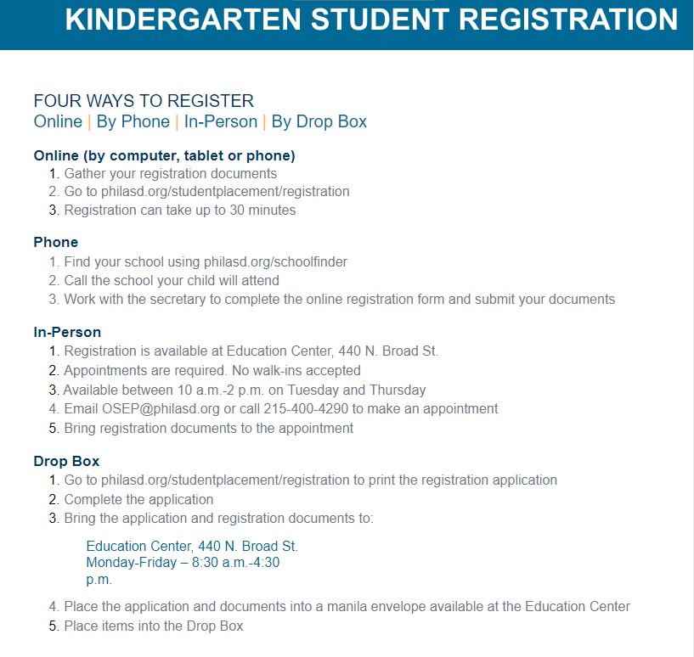

Slide 8
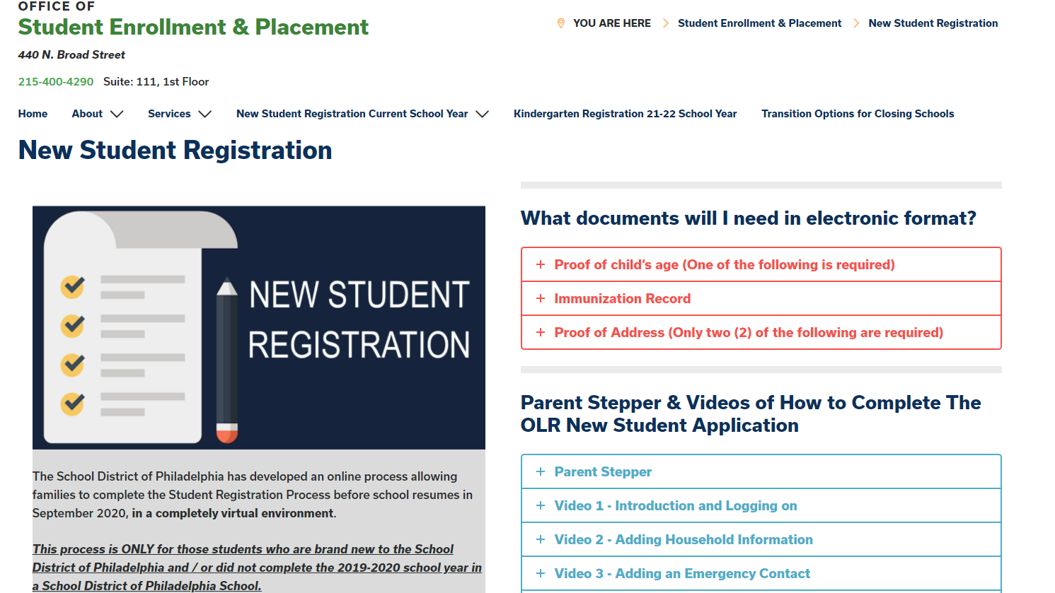
Enrollment Guidelines can be found on the School District page for the Office of Student Enrollment & Placement along with detailed instructions on how to complete enrollment online and videos detailing the process
Navigate to the Districts website: philasd.org/studentplacement/registration

Slide 9
Review of Parent Information Available Online
The following information is located on the Office of Specialized Services (OSS) Website. (philasd.org/specializedservices)
Next Steps for Kindergarten
Frequently Used Terms in School Aged Programs
The Differences Between School-Aged Services and Early Intervention Services
Pennsylvania Parent Guide to Special Education for School-Age Children

Slide 10
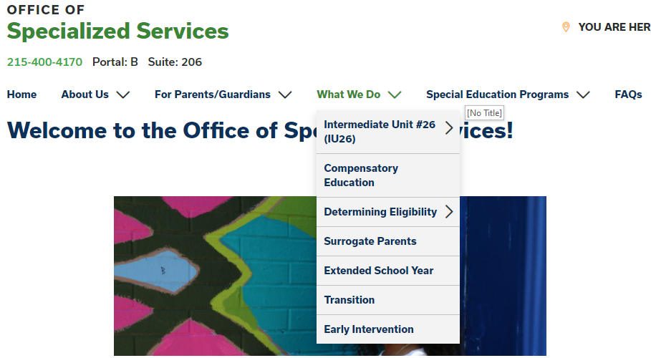
Review of Parent Information Available Online
This information can be accessed by Navigating to the Districts website: philasd.org/specializedservices
Move your curser over the title “What We Do”
Move your curser down and Click on “Early Intervention”
Click here

Slide 11
Notice of Transition Process Options
The School District can adopt the Early Intervention Individual Education Plan (IEP) for School-Age. Parent will receive a Notice of Recommended Educational Placement (NOREP).
The School District can adopt the Early Intervention Individual Education Plan with Revisions for School-Age. Parent will receive a Notice of Recommended Educational Placement (NOREP).
The School District can conduct an evaluation. Parent will receive a Permission to Re-Evaluate (PTRE) if additional assessments are being conducted.
You and the School District can decide to waive the reevaluation and develop an IEP.

Slide 12
IEP Process

Slide 13
Evaluation Process
Once your child is registered in a school and EI paperwork is shared with the school team, parents will receive a Permission to Re-Evaluate (PTRE) form that needs to be signed and returned to the school.
The PTRE allows the school psychologist to complete an evaluation that will determine if the child continues to be eligible to receive school-based services under a new eligibility category.
Once the evaluation is completed, the team will convene to review the results and determine next steps based on the eligibility determination.

Slide 14
Bilingual Process
Your family will be asked to complete a Home Language Survey when you register for Kindergarten.
If a language other than English is identified, the most appropriate method of assessment will be conducted.
Once the evaluation is completed, the team will convene to review the results and determine next steps based on the eligibility determination.

Slide 15
Full Continuum of Special Education Services
The School District of Philadelphia provides an extensive range of educational services and supports for students with diverse needs within our schools. There are different types and levels of support.

Slide 16
Full Continuum of Special Education Services
Type of Support
What Does Type of Support Mean?
The type of support simply means that based on your child’s specific needs, what kind of special education services should be implemented?

Slide 17
Full Continuum of Special Education Services
The Types of Support Available Include:
Autistic Support
Blind and Visually Impaired Support
Deaf and Hearing Impaired Support
Emotional Support
Learning Support
Life Skills Support
Multiple Disabilities Support.
Physical Support
Speech and Language Support

Slide 18
Full Continuum of Special Education Services
Level of Support
What Does Level of Support Mean?
The level of support is based on your child’s specific needs. It answers the question of how much special education services should be implemented?

Slide 19
Full Continuum of Special Education Services
The Level of Support Offered Include:
Full-time: Special education supports and services provided by special education personnel for 80 percent or more of the school day.
Supplemental: Special education supports and services provided by special education personnel for more than 20 percent but less than 80 percent of the school day.
Itinerant: Special education supports and services provided by special education personnel for 20 percent or less of the school day.

Slide 20
Least Restrictive Environment
Least Restrictive Environment (LRE) is part of the Individuals with Disabilities Education Act (IDEA).
IDEA says that children who receive special education should learn in the least restrictive environment.
This means they should spend as much time as possible with peers who do not receive special education.

Slide 21
Least Restrictive Environment
IDEA says two things about LRE that are important for everyone to understand
Your child should be with children in general education to the “maximum extent that is appropriate.”
Special classes, separate schools, or removal from the general education class should only happen when your child’s learning or thinking difference are so severe that supplementary aids and services can not provide your child with an appropriate education.

Slide 22
General Overview-Related Services
Blind and Vision Support
Hearing and Interpreting Support
Occupational Therapy
Physical Therapy
Speech and Language Therapy

Slide 23
Blind and Visually Impaired Support (BVI)
Blind and Visually Impaired Support are services for students with the disability of visual impairment including blindness, who require services to address needs primarily in the areas of accessing print and other visually-presented materials, orientation and mobility, accessing public and private accommodations, or use of assistive technologies designed for individuals with visual impairments or blindness.

Slide 24
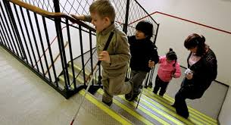
Blind and Visually Impaired Support (BVI)
*Itinerant - Orientation and Mobility Program
Students who are blind or who have severe visual impairments may receive orientation and mobility (O&M) services from Certified Orientation and Mobility Specialists (COMSs) within their current school. The COMS will provide service as outlined within the Individual Education Program (IEP)

Slide 25
Deaf & Hard of Hearing Program
Supplemental Level Programs Itinerant Level Services :
Locations:
Bache-Martin Elementary School K-8 Itinerant Teachers of the Deaf
John Hancock Demonstration School K-8 Sign Language Interpreters
Abraham Lincoln High School 9-12
Program service options:
Total Communication (focus on ASL)
Auditory / Oral
Inclusion with Interpreting Services
Inclusion with Teacher of the Deaf Support
Self-Contained Classes
Blended Model of Programming as needed
Life Skills Programming at the high school level

Slide 26
School Based Occupational Therapy
School-based occupational therapy practitioners support academic achievement and social participation by promoting occupation within all school routines, including recess, classroom, and cafeteria time. They help children fulfill their role as students.

Slide 27
School Based Physical Therapy
The primary role of the school PT is to help students benefit from their educational program within the educational environment.

Slide 28
Speech/Language Support
Speech and Language Support are services to support your child with a speech or language impairment that impacts their ability to communicate effectively during academic, social and/or vocational activities within the school curriculum
A Speech/Language Therapist will provide support services - individually, a small group, collaboratively with consultation provided to the IEP team or a combination of supports in order to ensure customized service to meet the functional communication needs of your child

Slide 30
QUESTIONS
&
CONCERNS
QUESTIONS, CONCERNS
AND
ANSWERS

